Slide 1
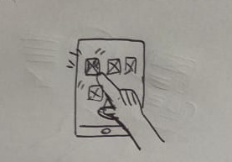
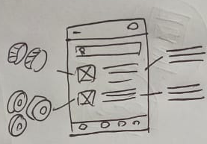
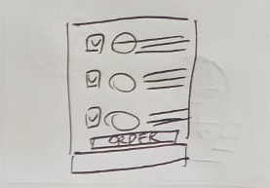
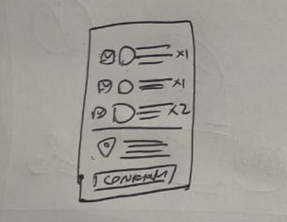
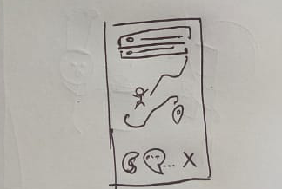
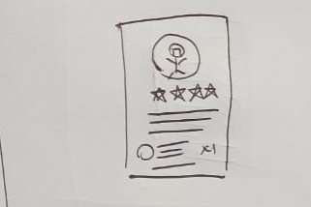
UX Design Storyboard
Scenario: an app for ordering sushi quickly and easily with knowing what the sushi is made out of.
Stephanie opens the app
She then chooses the sushi from the menu
Then check each sushi’s details
She then pick what she likes by checking all
The checkbox than put it to cart
After confirming the order she proceeds to press
The order button
The app will track the order process and will
Give gps location of the deliverer
Stephanie then give feedback for the food
And deliverer on the app

